Slide 1
STOR 455 Transformation & Model Diagnostics
Read: 1.4, 1.5
Exercises: #1.3, 5, 7, 9, 15, 17, 21, 23, 25, 27, 33

Slide 2
Simple Linear Model
response
random error
Y = β_{o} + β₁X + ε
intercept
predictor
slope
Assume: ε ~ N( 0, σ_{ε}) and independent
Three parameters to estimate: β_{o}, β₁, σ_{ε}

Slide 3
Simple Linear Model- Conditions
Model:
Linearity: The means for Y vary as a linear function of X.
Error:
Zero Mean: The distribution of the errors is centered at zero.
Constant variance: The variance for Y is the same at each X. (Homoscedasticity)
Independence: No relationships among errors.
Normality:
Residuals are normally distributed
(sometimes) At each X, the Y’s follow a normal distribution.

Slide 4
What to do when regression assumptions are violated?
Examples:
Nonlinear patterns in residuals
Heteroscedasticity (nonconstant variance)
Lack of normality in residuals
Outliers: influential points, large residuals

Slide 5
Data Transformations
Can be used to:
Address non-linear patterns
Stabilize variance
Remove skewness from residuals
Minimize effects of outliers

Slide 6





Common Transformations
For either the response (Y) or predictor (X)...
Logarithm
$$Y→log⁡(Y)$$
Square root
$$Y→\sqrt{Y}$$
Exponentiation
$$Y→e^{Y}$$
Power function
$$Y→Y^{3}$$
Reciprocal
$$Y→1/Y$$

Slide 7
Example: Mammal Species
Y = Number of mammal species on an island
X = Area of the island
Data on fourteen islands in Southeast Asia are stored in SpeciesArea (in Stats2Data)
data(SpeciesArea)
head(SpeciesArea)
Name Area Species logArea logSpecies
1 Borneo 743244 129 13.51880 4.85981
2 Sumatra 473607 126 13.06810 4.83628
3 Java 125628 78 11.74110 4.35671
4 Bangka 11964 38 9.38966 3.63759
5 Bunguran 1594 24 7.37400 3.17805
6 Banggi 450 18 6.10925 2.89037

Slide 8
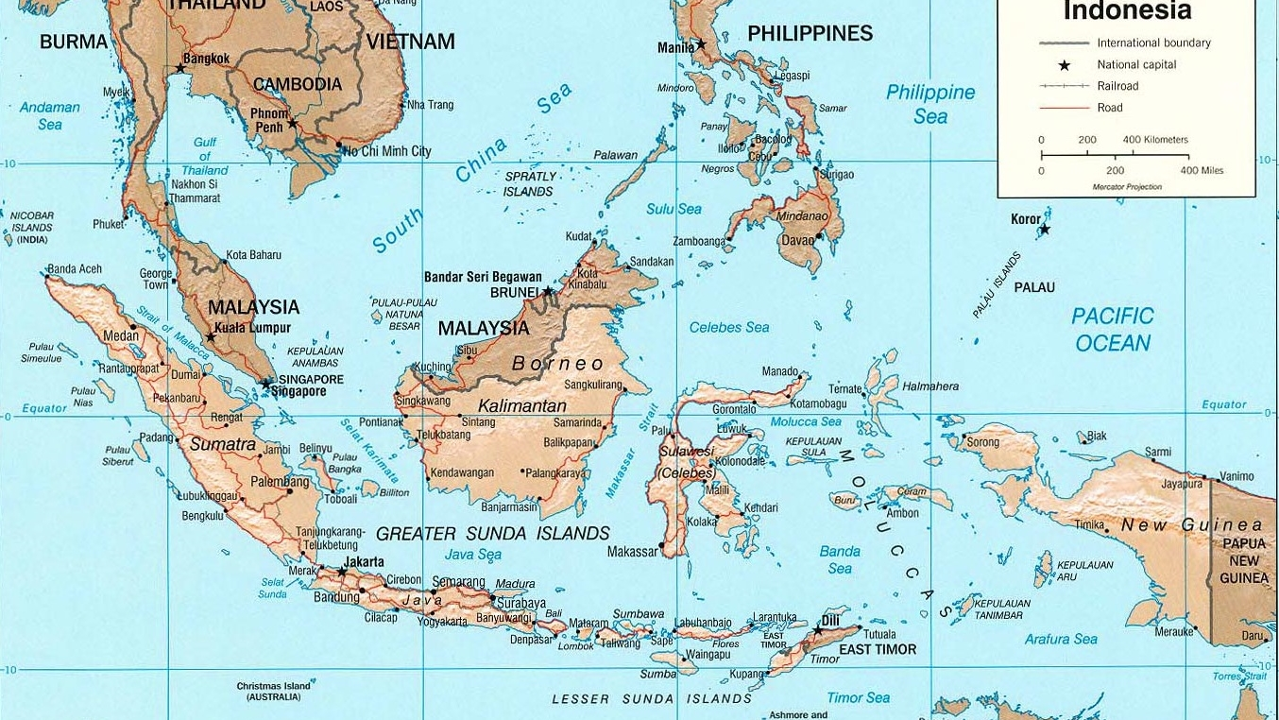

Slide 9
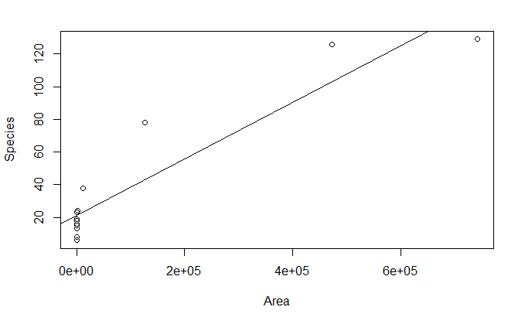
Mammal Species
plot(Species~Area, data=SpeciesArea)
SpeciesModel=lm(Species~Area, data=SpeciesArea)
abline(SpeciesModel)

Slide 10
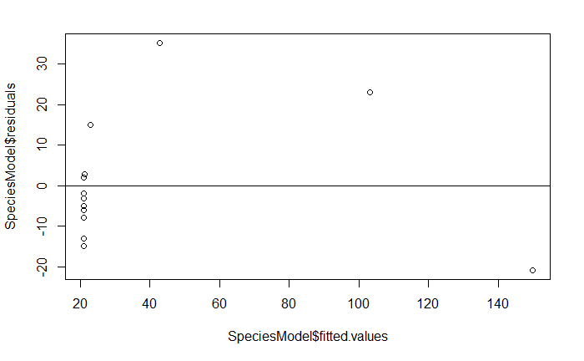
Mammal Species
plot(SpeciesModel$residuals~SpeciesModel$fitted.values)
abline(0,0)

Slide 11
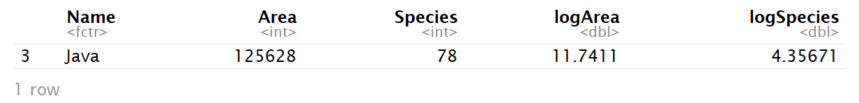
Mammal Species
max(SpeciesModel$residuals)
which.max(SpeciesModel$residuals)
[1] 35.24152
3
SpeciesArea[3,]

Slide 12
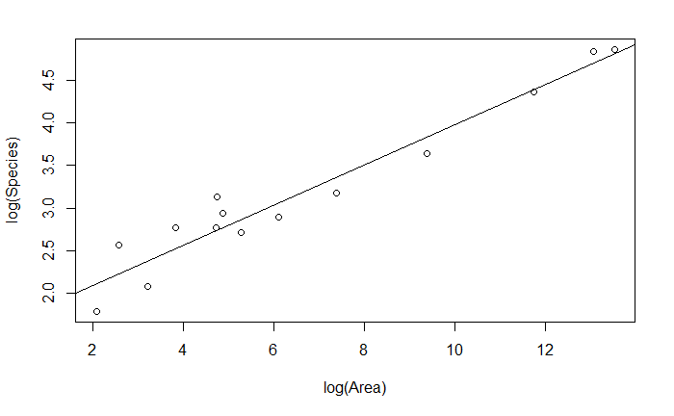
Mammal Species
plot(log(Species)~log(Area), data=SpeciesArea)
SpeciesModel2=lm(log(Species)~log(Area), data=SpeciesArea)
abline(SpeciesModel2)

Slide 13
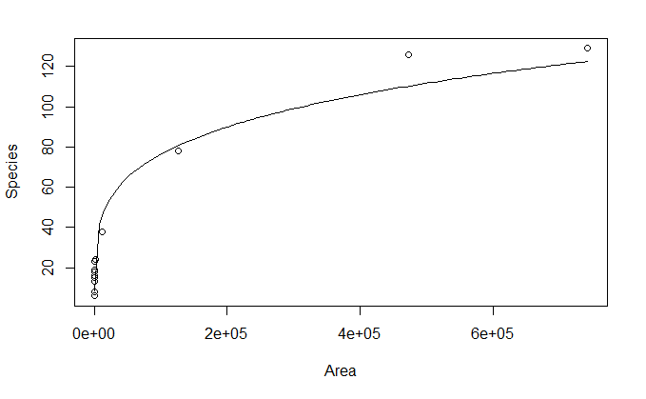
Mammal Species
B0 = summary(SpeciesModel2)$coefficients[1,1]
B1 = summary(SpeciesModel2)$coefficients[2,1]
plot(Species~Area, data=SpeciesArea)
curve(exp(B0)*x^B1, add=TRUE)

Slide 14
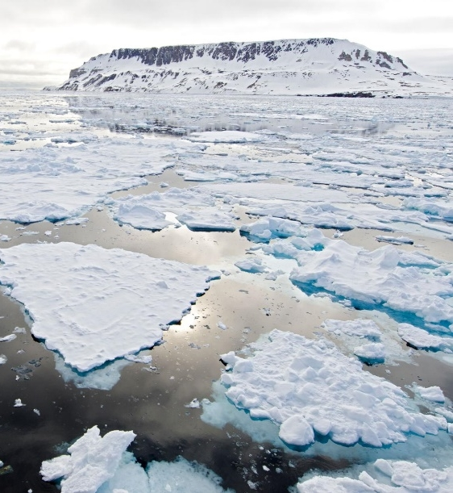
Artic Sea Ice
The SeaIce data gives information about the amount of sea in the arctic region as measured in September (the time when the amount of ice is at its least) since 1979. The basic research question is to see if we can use time to model the amount of sea ice.
In fact, there are two ways to measure the amount of sea ice: Area and Extent. Area measures the actual amount of space taken up by ice. Extent measures the area inside the outer boundaries created by the ice. If there are areas inside the outer boundaries that are not ice (think about a slice of swiss cheese), then the Extent will be a larger number than the Area. In fact, this is almost always true.

Slide 15
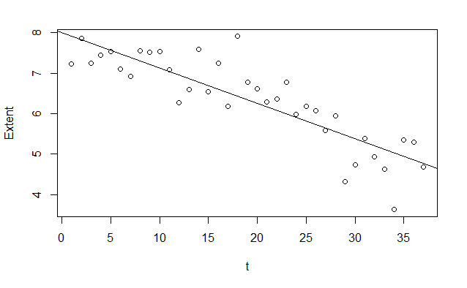
Artic Sea Ice
plot(Extent~t, data = SeaIce)
IceModel=lm(Extent~t, data = SeaIce)
abline(IceModel)

Slide 16
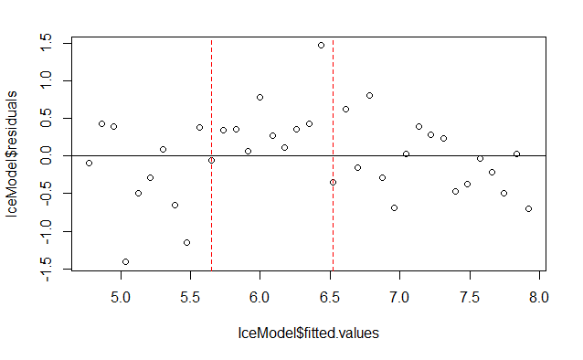
Artic Sea Ice
plot(IceModel$residuals~IceModel$fitted.values)
abline(0,0)
abline(v=c(5.65,6.52), col=c("red", "red"), lty=c(2,2), lwd=c(1, 1))

Slide 17
Types of “Unusual” Points in SLM
Outlier: A data point that is far from the regression line.
Influential point: A data point that has a large effect on the regression fit.
How do we measure “far”?
How do we measure “effect on the fit”?

Slide 18
Detecting Unusual Cases - Overview
1. Compute residuals
“raw”, standardized, studentized
2. Plots of residuals (or std. residuals)
Boxplot, scatterplot, normal plot
3. Leverage
Unusual values for the predictors
4. Cook’s distance
Cases with large influence

Slide 19
Raw Residual
How can we tell if a residual is unusually large?
Example:
Y = GPA e_{i} = 2.6 is very large
Y = SAT e_{i} = 2.6 is very small

Slide 20
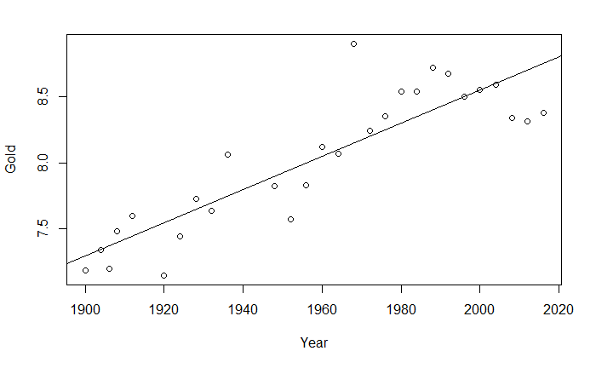
Example: Men’s Olympic Long Jump
LongJumpOlympics2016
Bob Beamon (1968)

Slide 21
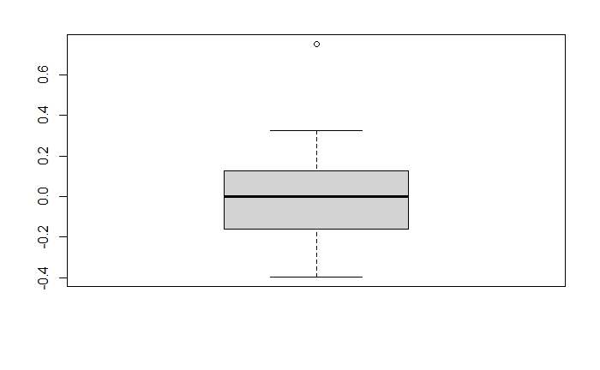
Outliers are more than 1.5 IQR’s beyond the Quartiles
1.5⋅IQR
Q₃
IQR
m
1.5⋅IQR
Q₁

Slide 22
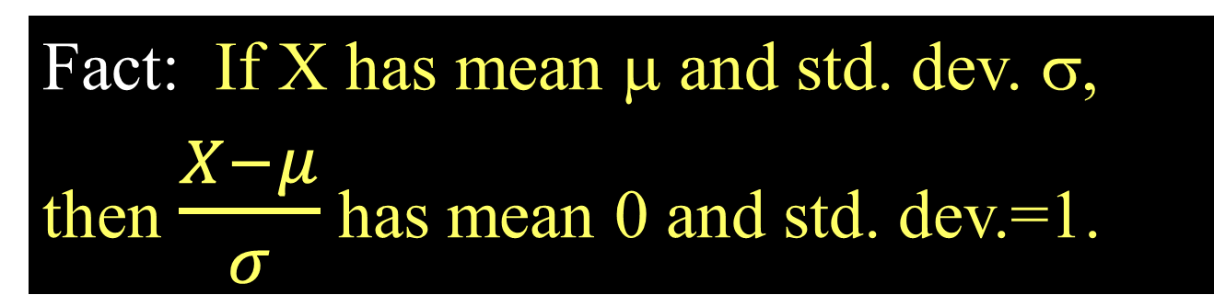

Standardized Residuals
Fact: If X has mean μ and std. dev. σ,
then $\frac{X−μ}{σ}$ has mean 0 and std. dev.=1.
For residuals: mean=0 and std. dev. $≈{\hat{σ}}_{ε}$
Standardized
Residual ≈
Look for values
beyond ±2 (mild) or beyond ±3
(almost)

Slide 23
Standardized Residuals in R
Once you have fit mymodel=lm(Y~X)
Use: rstandard(mymodel)
GoldModel=lm(Gold~Year,data=LongJumpOlympics2016)
rstandard(GoldModel)
1 2 3 4 5 6
-0.45846037 -0.02447194 -0.69927805 0.34245659 0.62395356 -1.58872766
7 8 9 10 11 12
-0.60354515 0.33349306 -0.22282237 1.24041457 -0.28038843 -1.47783119
13 14 15 16 17 18
-0.65303672 0.28865616 -0.10391829 2.96025507 0.17095826 0.40756162
19 20 21 22 23 24
0.96124413 0.76569814 1.28443310 0.89029407 0.01303494 0.01295953
25 26 27 28
-0.02754601 -1.24791995 -1.58338033 -1.51206192
max(rstandard(GoldModel))
[1] 3.02588100

Slide 24
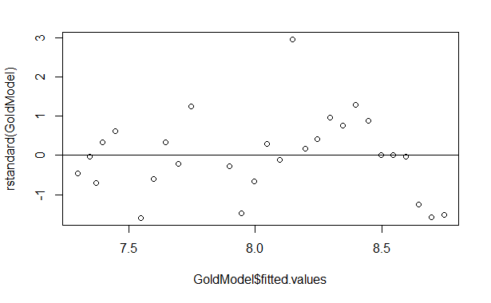
Plot: Standardized Residuals vs. Predicted
2.96

